Slide 1

ML System Design: Core Concepts
A practical guide to model selection, training architecture, evaluation, and production trade-offs — the systematic decisions that separate a prototype from a production-grade machine learning system.

Slide 3
Model Selection Strategies
Model selection is not just about picking the algorithm with the highest accuracy — it is a systematic process of balancing complexity, interpretability, and operational constraints.
1
2
3
Heuristic / Baseline First
Validation Frameworks
Hyperparameter Optimization
Always start with a simple, interpretable baseline (e.g., Logistic Regression). This sets a performance floor and quantifies the ROI of more complex models.
K-Fold Cross-Validation: Best for static, tabular datasets. Time-Series Split (Rolling Window): Crucial for temporal data to prevent future data leakage.
Grid Search: Exhaustive but expensive. Random Search: More efficient. Bayesian Optimization: Builds a probability model iteratively, drastically reducing search time.

Slide 4
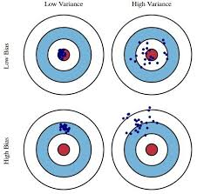
The Bias-Variance Tradeoff
This core concept defines a model's ability to generalize to unseen data. Every model lives somewhere on the spectrum between underfitting and overfitting.
Bias (Underfitting)
Variance (Overfitting)
The model is too simple, missing relevant relations between features and targets.
Fixes: Increase complexity, add features, reduce regularization.
The model is too sensitive to training noise, failing to generalize.
Fixes: Add data, simplify architecture, increase regularization (L1/L2, dropout), use ensembles.

Slide 5

Diagnosing Bias & Variance
Use training vs. validation error as your diagnostic signal to identify where your model sits on the bias-variance spectrum.
Metric State
Cause
Diagnosis
High Bias, Low Variance
Model is too simple
High training error, High validation error
Low Bias, High Variance
Model is too complex
Low training error, High validation error
Low Bias, Low Variance
Ideal Scenario
Low training error, Low validation error
The goal is always to reach Low Bias + Low Variance — low error on both training and held-out validation data.

Slide 6
Training vs. Inference Architecture
Designing an ML system requires separating the heavy, throughput-oriented training phase from the SLA-driven, low-latency inference phase.
Training Architecture
Inference Architecture
Goal: Maximize throughput and resource utilization (GPUs/TPUs).
Batch processing, distributed computing, stateful checkpoints, and high storage bandwidth to ingest massive datasets.
Goal: Minimize latency and maximize availability.
Often stateless and lightweight, scaled horizontally. Features served via low-latency NoSQL databases or computed on-the-fly using feature stores.

Slide 7

Offline vs. Online Learning
How and when does the model learn from new data? The answer shapes your entire data pipeline and monitoring strategy.
Offline (Batch) Learning
Trained periodically (nightly/weekly) on accumulated data. Easy to implement and stable, but cannot adapt quickly to sudden data distribution shifts (Data Drift).
Online (Continual) Learning
Updates weights incrementally as new data arrives in real-time. Highly responsive to trends, but susceptible to "catastrophic forgetting" and corruption by bad data. Requires complex rollback monitoring.

Slide 8
Evaluation Metrics: Business-Driven
Statistical metrics (AUC-ROC, MSE, F1-Score) must map directly to business KPIs to justify value. The translation layer is critical.
Fraud Detection
E-commerce Recommendation
Confusion Matrix Alignment
Don't just maximize F1-Score. Minimize False Negatives (missed fraud = high financial cost) while keeping False Positives (blocked cards = user friction) at an acceptable threshold.
Don't just optimize NDCG. Measure the lift in Click-Through Rate (CTR) or Average Order Value (AOV) via A/B testing.
High FP cost (e.g., spam filtering): Optimize for Precision. High FN cost (e.g., cancer detection): Optimize for Recall.

Slide 9
Model Versioning & Reproducibility
An ML model is a combination of Code + Data + Hyperparameters. Versioning git code alone is insufficient for true reproducibility.
Data Versioning
Experiment Tracking
Model Registry
Tools like DVC or Delta Lake track dataset hashes, ensuring you can retrain on the exact same data split.
Tools like MLflow or Weights & Biases log hyperparameters, artifacts, dependencies, and metrics for every run.
A centralized hub managing model states (Staging, Production, Archived). Models are packaged with Docker or compiled to ONNX/TensorRT for immutable deployments.

Slide 10
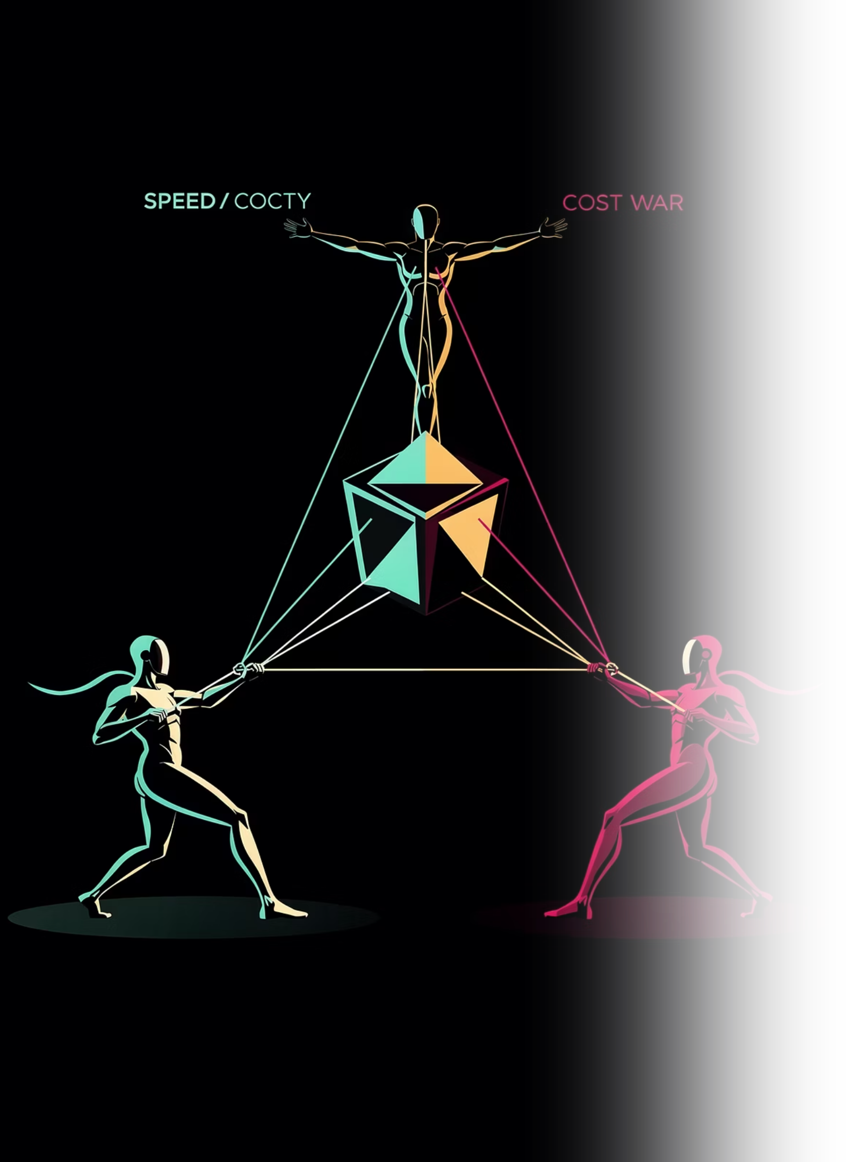
Trade-offs: Accuracy vs. Latency vs. Cost
In production engineering, you rarely get to maximize all three. You must design your system around the bottleneck.
Accuracy vs. Latency
Complex models yield higher accuracy but longer inference times. A tight SLA (e.g., ad bidding) may require sacrificing 2% accuracy for a lighter, faster distilled model.
Accuracy vs. Cost
State-of-the-art models require expensive GPU/TPU infrastructure. The key question: does a 1% accuracy gain generate enough revenue to offset an extra $10,000/month in cloud costs?

Slide 11



Mitigation Strategies for Production
Three proven techniques to reduce latency and cost without sacrificing meaningful accuracy in production deployments.
Quantization
Knowledge Distillation
Caching
Converting weights from FP32 to INT8 to decrease latency and memory footprint with minimal loss in accuracy.
Training a smaller "student" model to mimic a large, accurate "teacher" model — capturing performance at a fraction of the cost.
Using a cache (e.g., Redis) for frequent or predictable queries to completely bypass model inference costs and latency.

Slide 12
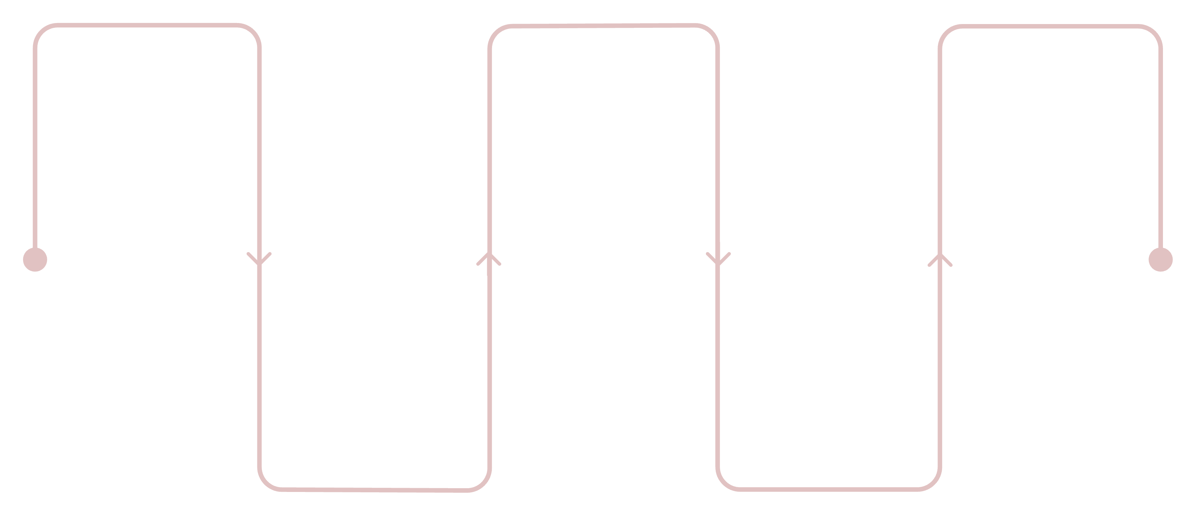
End-to-End ML System: At a Glance
Select Model
Version & Track
Monitor & Iterate
Choose architecture and features
Record artifacts and experiments
Observe performance and improve
Deploy (Train/Inference)
Train & Validate
Fit models and evaluate metrics
Release pipelines for use
A production ML system is a continuous loop — not a one-time deployment. Each stage feeds back into the next, requiring disciplined versioning, monitoring, and iteration to maintain performance over time.

Slide 13

Key Takeaways
Start Simple
Always establish a baseline before reaching for complex models. Quantify the ROI of added complexity.
Separate Training & Inference
Design each phase for its own goal — throughput for training, low latency for inference.
Version Everything
Code, data, and hyperparameters must all be versioned together for true reproducibility.
Align Metrics to Business
Statistical performance only matters if it maps to real business KPIs. Design your evaluation strategy accordingly.

